Slide 1
Introduction to Database Systems
Lecture 09: E/R Diagrams (4.1-6)
and Constraints (7.1-2)
1

Slide 2
Database Design
What it is:
Starting from scratch, design the database schema: relation, attributes, keys, foreign keys, constraints etc.
Why it’s hard:
The database will be in operation for years.
Updating the schema in production is very hard:
schema change modifications are expensive (why?)
making the change without introducing any bugs is hard
this part is, by far, the most important consideration in practice
2

Slide 3
Database Design
Consider issues such as:
What entities to model
How entities are related
What constraints exist in the domain
Several formalisms exists
We discuss E/R diagrams
Reading: Sec. 4.1-4.6
3

Slide 4










Database Design Process
Conceptual Model:
name
product
makes
company
price
name
address
Relational Model: Tables + constraints And also functional dep.
Normalization: Eliminates anomalies
Conceptual Schema
Physical storage details
Physical Schema
4

Slide 5



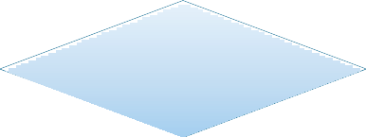

Entity / Relationship Diagrams
Entity set = a class
– An entity = an object
Product
Attribute
city
Relationship
makes
5

Slide 6
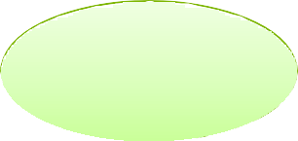



















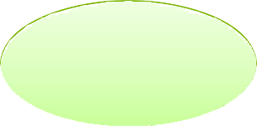




name
CEO
name
price
makes
Company
Product
address
buys
employs
Person
address
name
ssn
6

Slide 7




Keys in E/R Diagrams
Every entity set must have a key
name
price
Product
7

Slide 8




What is a Relation(ship)?
A mathematical definition:
– if A, B are sets, then a relation R is a subset of A × B
A = {1, 2, 3}, B = {a, b, c, d},
A × B = {(1,a), (1,b), . . ., (3,d)}
R = {(1,a), (1,c), (3,b)}
1
a
b c d
2
A=
3
B=
makes is a subset of Product × Company:
makes Company
Product
8

Slide 9





Multiplicity of E/R Relations
one-one:
1
2
3
many-one
1
2
3
a b c d
a b c d
many-many
1
2
3
a
b c
d
9

Slide 10








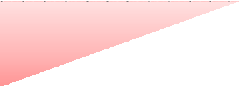












name
CEO
name
price
makes
Company
Product
address
What does this say ?
buys
employs
Person
address
name
ssn
10

Slide 11





Multi-way Relationships
How do we model a purchase relationship between buyers, products and stores?
Product
Purchase
Store
Person
Can still model as a mathematical set (Q. how ?)
A. As a set of triples ⊆ Person × Product × Store
12

Slide 12








Arrows in Multiway Relationships
Q: What does the arrow mean ?
Product
Purchase Store
Person
A: A given person buys a given product from at most one store [Arrow pointing to E means that if we select one entity from each of the other entity sets in the relationship, those entities are related to
at most one entity in E]
13

Slide 13





Arrows in Multiway Relationships
Q: What does the arrow mean ?
Product
Purchase
Store
Person
A: A given person buys a given product from at most one store AND every store sells to every person at most one product
13

Slide 14


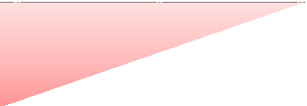



Converting Multi-way Relationships to Binary
date
ProductOf Product
Purchase
StoreOf
Store
BuyerOf
Person
Arrows go in which direction?
14

Slide 15



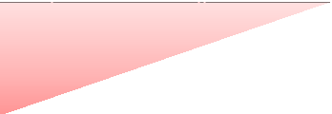


Converting Multi-way Relationships to Binary
date
ProductOf Product
Purchase
StoreOf
Store
BuyerOf
Person
Make sure you understand why!
15

Slide 16

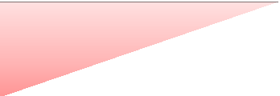

3. Design Principles
What’s wrong?
Product
Purchase
Person
Country
President
Person
Lesson: be faithful to the specifications of the app!
16

Slide 17





Design Principles: What’s Wrong?
date
Product
Purchase
Store
Lesson: pick the right kind of entities.
personAddr
personName
17

Slide 18




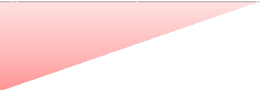
Design Principles: What’s Wrong?
Dates
date
Product
Purchase
Store
Lesson: don’t complicate life more than it already is.
Person
18

Slide 19
From E/R Diagrams to Relational Schema
Entity set → relation
Relationship → relation
19

Slide 20





Entity Set to Relation
prod-ID category
price
Product
Product(prod-ID, category, price)
prod-ID | category | price
Gizmo55 | Camera | 99.99
Pokemn19 | Toy | 29.99
20

Slide 21











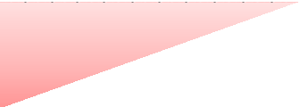



N-N Relationships to Relations
prod-ID cust-ID
date
name
date
Orders
Shipment
Shipping-Co
address
Represent this in relations
21

Slide 22












N-N Relationships to Relations
prod-ID cust-ID
date
name
date
Orders
Shipment
Shipping-Co
Orders(prod-ID, cust-ID, date)
Shipment(prod-ID, cust-ID, name, date)
address
Shipping-Co(name, address)
prod-ID | cust-ID | name | date
Gizmo55 | Joe12 | UPS | 4/10/2011
Gizmo55 | Joe12 | FEDEX | 4/9/2011
22

Slide 23













N-1 Relationships to Relations
prod-ID cust-ID
date
name
date
Orders
Shipment
Shipping-Co
address
Represent this in relations
23

Slide 24












N-1 Relationships to Relations
prod-ID cust-ID
date
name
date
Orders
Shipment Shipping-Co
address
Orders(prod-ID, cust-ID, date1, ship_co, ship_date)
Shipping-Co(name, address)
Remember: many-one relationship becomes FK, not relation
24

Slide 25





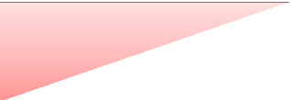







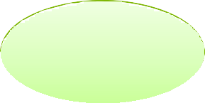


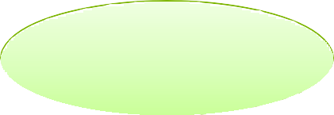







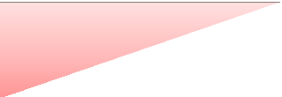






Ex: NFL Game DB
Play
Team
play_id
yardline
team_id
city
receiving_yds
PlaysFor
PlayedIn
Player
PlayedIn(play_id, player_id, receiving_yds, …)
player_id
name
(Actually, the key of Play is not play_id. More on this later...)
25

Slide 26




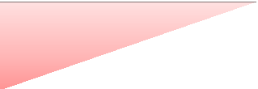





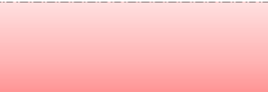









Multi-way Relationships to Relations
name
address
Product
prod-ID
price
Purchase
Store
Person
Purchase(prod-ID, ssn, name)
ssn
name
26

Slide 27
Modeling Subclasses
Some objects in a class may be special
define a new class
better: define a subclass
Products
Software products
Educational products
So --- we define subclasses in E/R
27

Slide 28






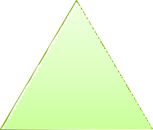


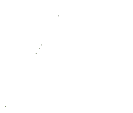






Subclasses
name
category
price
Product
isa
isa
Software Product
Educational Product
platforms
Age Group
28

Slide 29





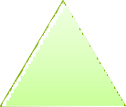
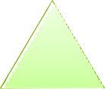





Subclasses to Relations (one option)
Product
Name | Price | Category
Gizmo | 99 | gadget
Camera | 49 | photo
Toy | 39 | gadget
name category
price
Product
Sw.Product
Name | platforms
Gizmo | unix
isa
isa
Software Product
Educational Product
Ed.Product
Name | Age Group
Gizmo | toddler
Toy | retired
platforms
Age Group
Other ways to convert are possible…
29

Slide 30




Modeling Union Types with Subclasses
FurniturePiece
Person
Company
Say: each piece of furniture is owned either by a person or by a company
30

Slide 31










Modeling Union Types with Subclasses
Say: each piece of furniture is owned either by a person or by a company
Solution 1. Acceptable but imperfect (What’s wrong?)
Person FurniturePiece Company
ownedByPerson
ownedByComp.
31

Slide 32


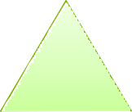









Modeling Union Types with Subclasses
Solution 2: better, more laborious
Owner
isa
isa
ownedBy
Person
Company
FurniturePiece
32

Slide 33




Weak Entity Sets
Entity sets are weak when their key comes from other classes to which they are related.
Team
affiliation
University
sport
number
name
Team(sport, number, universityName) University(name)
33

Slide 34






Integrity Constraints Motivation
An integrity constraint is a condition specified on a database schema that restricts the data that can be stored in an instance of the database.
Most important issue in practice
ICs help prevent entry of incorrect information
How? DBMS enforces integrity constraints
Allows only legal database instances (i.e., those that satisfy all constraints) to exist
Ensures that all necessary checks are always performed and avoids duplicating the verification logic in each application
34

Slide 35
Constraints in E/R Diagrams
Finding constraints is part of the modeling process. Commonly used constraints:
Keys: social security number uniquely identifies a person. Single-value constraints: can have only one genetic father Referential integrity constraints: if you work for a company, it
must exist in the database.
Other constraints: peoples’ ages are between 0 and 150.
some values should not be NULL
35

Slide 36









Keys in E/R Diagrams
name category
Underline:
price
No formal way to specify multiple keys in E/R diagrams
Product
Person
address
name
ssn

Slide 37






Single Value Constraints
makes
vs.
makes

Slide 38



Referential Integrity Constraints
makes
Product Company
Each product made by at most one company.
Some products made by no company
Which one is FK?
makes
Product Company
Each product made by exactly one company.

Slide 39


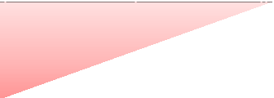
Other Constraints
<100
Product
makes
Company
Q: What does this mean ?
A: A Company entity cannot be connected
by relationship to more than 99 Product entities

Slide 40




Constraints in SQL
Constraints in SQL:
Keys, foreign keys
Attribute-level constraints
Tuple-level constraints
Global constraints: assertions
simplest
Most complex
The more complex the constraint, the harder it is to check and to enforce…
– (Still, performance is secondary to correctness.)

Slide 41
Key Constraints
Product(name, category)
CREATE TABLE Product (
name CHAR(30) PRIMARY KEY,
category VARCHAR(20))
OR:
CREATE TABLE Product ( name CHAR(30), category VARCHAR(20), PRIMARY KEY (name))

Slide 42
Keys with Multiple Attributes
Product(name, category, price)
CREATE TABLE Product ( name CHAR(30), category VARCHAR(20), price INT,
PRIMARY KEY (name, category))
Name | Category | Price
Gizmo | Gadget | 10
Camera | Photo | 20
Gizmo | Photo | 30
Gizmo | Gadget | 40

Slide 43
Other Keys
CREATE TABLE Product ( productID CHAR(10), name CHAR(30), category VARCHAR(20), price INT,
PRIMARY KEY (productID), UNIQUE (name, category))
There is at most one PRIMARY KEY; there can be many UNIQUE

Slide 44







Foreign Key Constraints
Referential
CREATE TABLE Purchase ( prodName CHAR(30)
REFERENCES Product(name), date DATETIME)
integrity constraints
prodName is a foreign key to Product(name)
name must be a key in Product
(i.e., PK or UNIQUE)
May write just Product if name is PK

Slide 45
Foreign Key Constraints
Example with multi-attribute primary key
CREATE TABLE Purchase ( prodName CHAR(30), category VARCHAR(20), date DATETIME,
FOREIGN KEY (prodName, category) REFERENCES Product(name, category))
(name, category) must be a KEY in Product

Slide 46
What happens when data changes?
Types of updates:
In Purchase: insert/update
In Product: delete/update
Product
Purchase
Name | Category
Gizmo | gadget
Camera | Photo
OneClick | Photo
ProdName | Store
Gizmo | Wiz
Camera | Ritz
Camera | Wiz

Slide 47
What happens when data changes?
SQL has three options for maintaining referential integrity on changes:
RESTRICT not allowed
NO ACTION reject bad modifications (default)
CASCADE after delete/update do delete/update
SET NULL set foreign-key field to NULL
SET DEFAULT set FK field to default value
– need to be declared with column, e.g.,
CREATE TABLE Product (pid INT DEFAULT 42)

Slide 48
Maintaining Referential Integrity
CREATE TABLE Purchase ( prodName CHAR(30), category VARCHAR(20), date DATETIME,
FOREIGN KEY (prodName, category) REFERENCES Product(name, category) ON UPDATE CASCADE
ON DELETE SET NULL)
Product Purchase
Name | Category
Gizmo | gadget
Camera | Photo
OneClick | Photo
ProdName | Category
Gizmo | gadget
Snap | Camera
EasyShoot | Camera

Slide 49
Constraints on Attributes and Tuples
Constraints on attributes: NOT NULL
CHECK condition
Constraints on tuples CHECK condition
-- obvious meaning...
-- any condition !

Slide 50
Constraints on Attributes and Tuples
CREATE TABLE Product ( productID CHAR(10), name CHAR(30), category VARCHAR(20),
price INT CHECK (price > 0), PRIMARY KEY (productID))

Slide 51
Constraints on Attributes and Tuples
CREATE TABLE Product ( productID CHAR(10), name CHAR(30), category VARCHAR(20)
CHECK (category in (‘toy’, ‘gadget’, ‘apparel’)), price INT CHECK (price > 0),
PRIMARY KEY (productID))

Slide 52
Constraints on Attributes and Tuples
CREATE TABLE Product ( productID CHAR(10),
name CHAR(30) NOT NULL,
category VARCHAR(20)
CHECK (category in (‘toy’, ‘gadget’, ‘apparel’)), price INT CHECK (price > 0),
PRIMARY KEY (productID))

Slide 53
Constraints on Attributes and Tuples
CREATE TABLE R (
A int NOT NULL,
B int CHECK (B > 50 and B < 100),
C varchar(20), D int,
CHECK (C >= 'd' or D > 0))

Slide 54




Constraints on Attributes and Tuples
What does this constraint do?
What is the difference from Foreign Key?
CREATE TABLE Purchase ( prodName CHAR(30)
CHECK (prodName IN
(SELECT Product.name FROM Product)),
date DATETIME NOT NULL)

Slide 55
General Assertions
CREATE ASSERTION myAssert CHECK (NOT EXISTS(
SELECT Product.name FROM Product, Purchase
WHERE Product.name = Purchase.prodName GROUP BY Product.name
HAVING count(*) > 200) )
But most DBMSs do not implement assertions, because it is hard to support them efficiently.
Instead, DBMSs provide triggers

